Slide 1
Week Eleven Vocabulary
English II

Slide 2
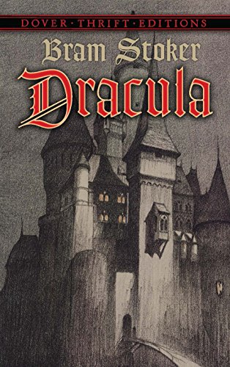
Epistle
a letter or literary composition in letter form

Slide 3
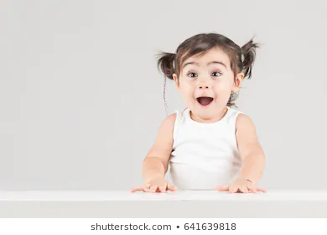
Avid
enthusiastic; extremely interested

Slide 4
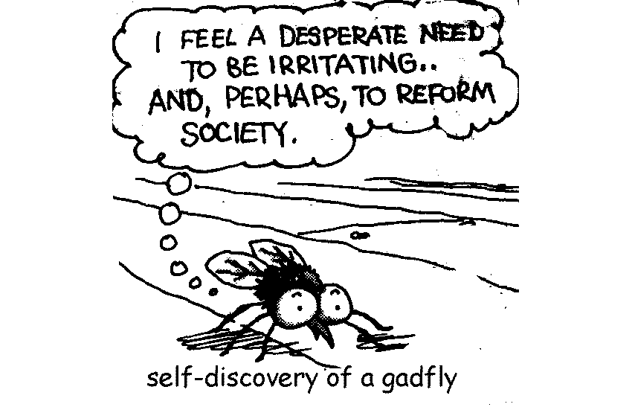
Gadfly
an irritating and persistent person

Slide 5
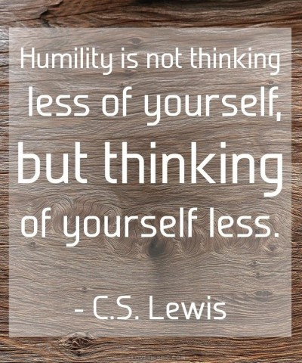
Humility
absence of vanity; humbleness

Slide 6
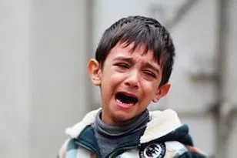
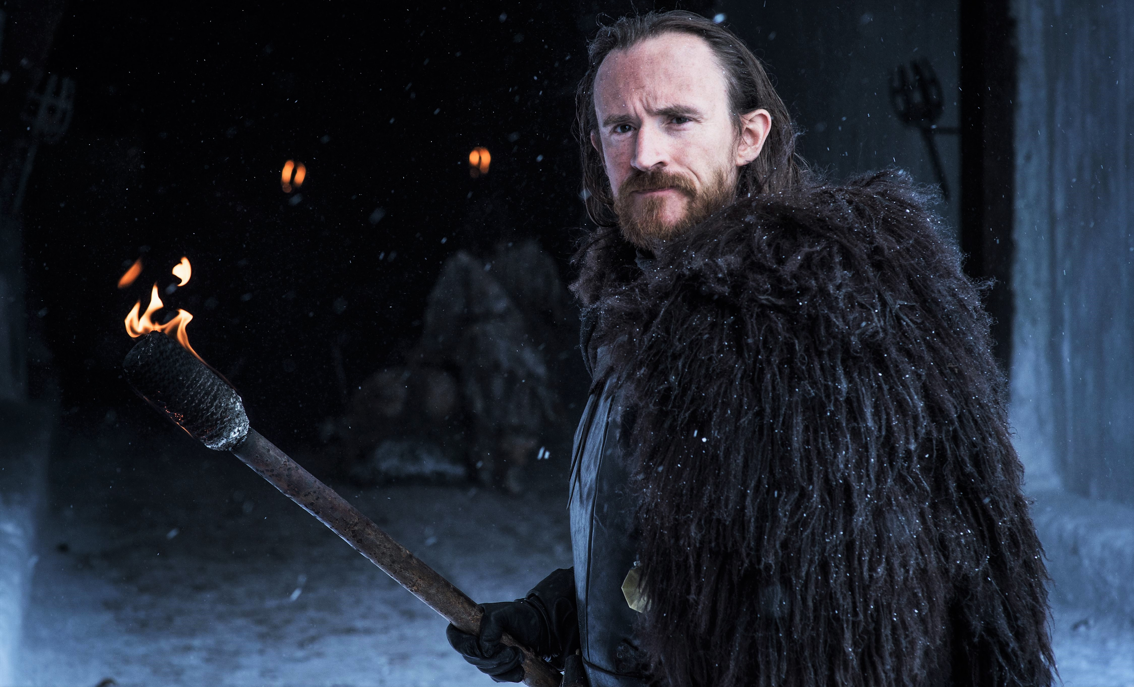
Dolorous
exhibiting sorrow or pain

Slide 7
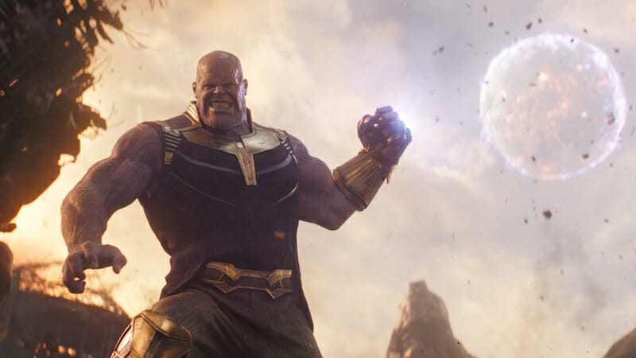
Gargantuan
of huge or extraordinary size and power

Slide 8
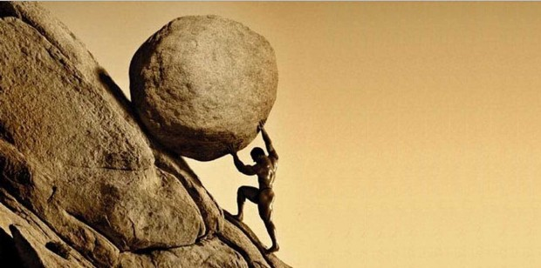
Arduous
difficult; requiring much effort

Slide 9
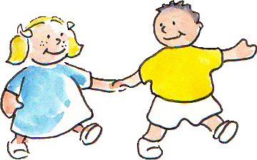
Affable
friendly; agreeable; easy to talk to

Slide 10
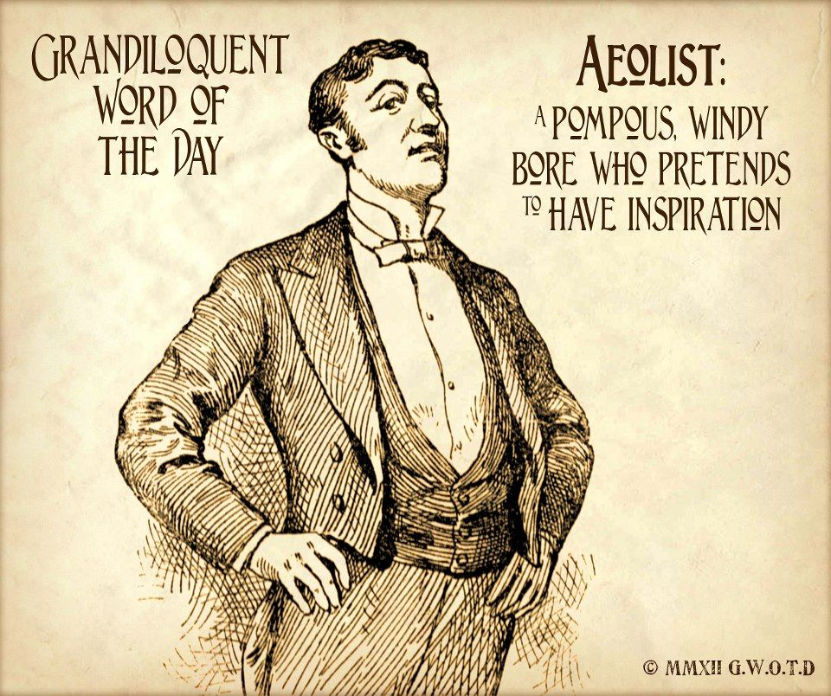
Grandiloquent
pompous or high-flown in speech

Slide 11
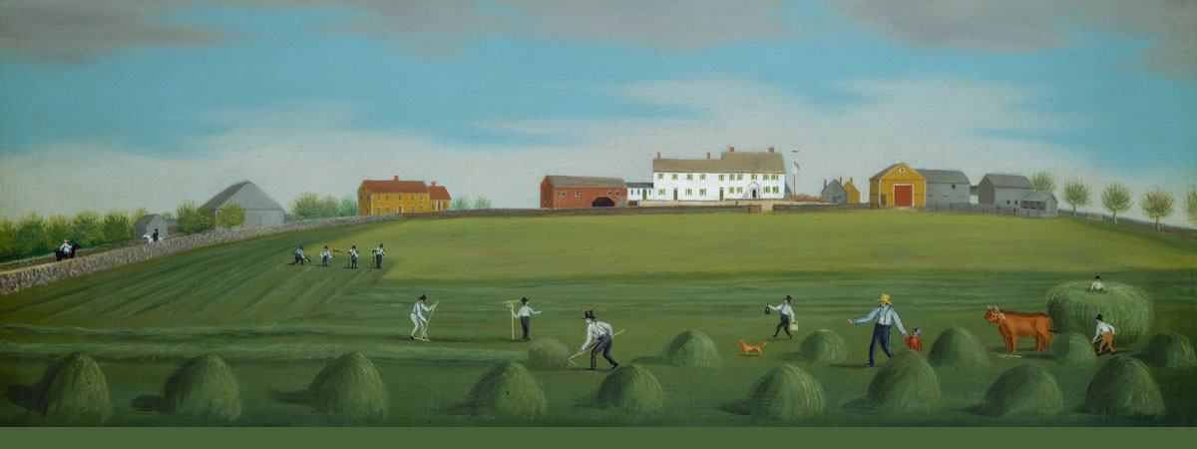
Agrarian
concerning farms, farmers, or the use of land

